Slide 1

Test Automation Using Selenium
Name of the presenter:
Date: Wednesday, July 16, 2014

Slide 2
Test Automation
Test automation is the use of software
To set test preconditions.
To control the execution of tests.
To compare the actual outcomes to predicted outcomes.
To report the Execution Status.
Commonly, test automation involves automating a manual process already in place that uses a formalized testing process.

Slide 3
Why and When To Automate?
Frequent regression testing
Repeated test case Execution is required
User Acceptance Tests
Faster Feedback to the developers
Reduce the Human Effort
Test same application on multiple environments

Slide 4
Test Automation Tools
Quick Test Professional By HP
Rational Functional Tester By Rational (IBM Company)
Silk Test By Borland
Test Complete By Automated QA
QA Run (Compuware )
Watir ( Open Source)
Selenium ( Open Source)
Sahi (Open Source)

Slide 5
Selenium
Selenium is a robust set of tools that supports rapid development of test automation for web-based applications.
Selenium provides a rich set of testing functions specifically geared to the needs of testing of a web application.
Selenium operations are highly flexible, allowing many options for locating UI elements and comparing expected test results against actual application behavior.

Slide 6
Selenium Features
Supports Cross Browser Testing. The Selenium tests can be run on multiple browsers.
Allows scripting in several languages like Java, C#, PHP and Python.
Assertion statements provide an efficient way of comparing expected and actual results.
Inbuilt reporting mechanism.

Slide 7
Selenium Components
Selenium IDE
Selenium Remote Control
Selenium Grid

Slide 8
Selenium IDE
Selenium IDE is an integrated development environment for Selenium tests.
It is implemented as a Firefox extension, and allows you to record, edit, and replay the test in firefox
Selenium IDE allows you to save tests as HTML, Java, Ruby scripts, or any other format
It allows you to automatically add assertions to all the pages.
Allows you to add selenese commands as and when required

Slide 9
Selenium IDE Installation
Using Firefox, first, download the IDE from the SeleniumHQ downloads page When downloading from Firefox, you’ll be presented with the Window A. (See Next Slide)
Select Install Now. The Firefox Add-ons window pops up, first showing a progress bar, and when the download is complete, displays the Window B. (See Next Slide)
Restart Firefox. After Firefox reboots you will find the Selenium-IDE listed under the Firefox Tools menu.

Slide 10
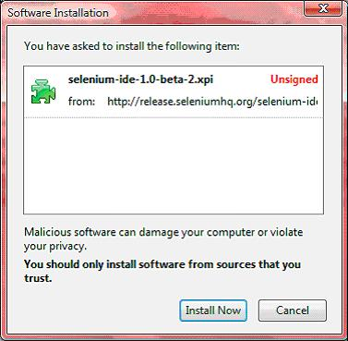
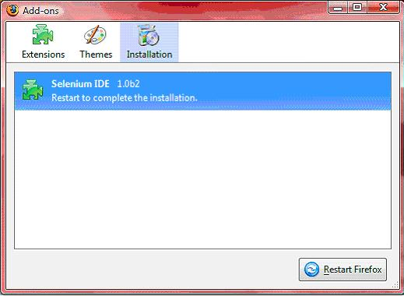
Selenium Installation
Window A
Window B
To run the Selenium-IDE, simply select it from the Firefox Tools menu. It opens as follows with an empty script-editing window and a menu for loading, or creating new test cases. (See Next Slide)

Slide 11
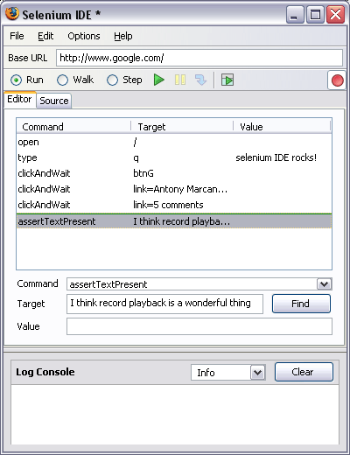
Selenium IDE - UI
Start and Stop
Recording
Replay
Toolbar
Selenese
Script
Editor
Accessor
Area
Selenium Log

Slide 12
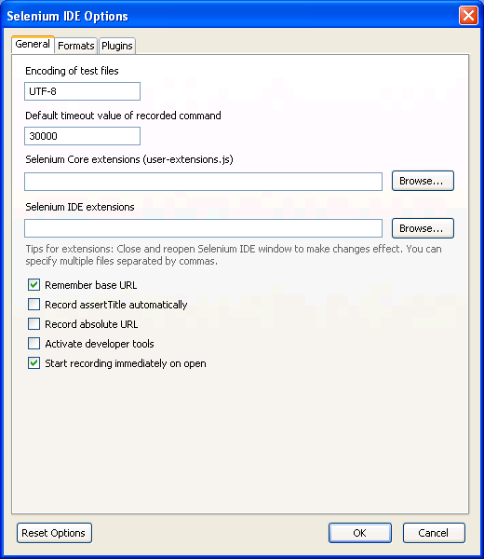
Selenium Options
Selenium Options allow you to
Set The Text Encoding Format
Set the Default Page Time Out
Set The Base URL recording option
Adding Selenium Core and IDE Extension
Add Automatic Page Title Assertions
There are also other options under development

Slide 13
Recoding a Selenium Test Case
Open Firefox that has the IDE installed
Open the base URL of the application to record.
Keep the application in a common base state.
Go To Tools → Selenium IDE and the IDE will be opened
Now perform the operations on the application as you are testing the application.
Once you are done with the recording click on the stop recording button and save the test case through the file menu. By default it will be saved as a selenese script (HTML format)

Slide 14
General Selenese Commands
clicking a link - click or clickAndWait commands
entering values - type command
selecting options from a drop-down listbox - select command
clicking checkboxes or radio buttons - click command

Slide 15
Running Your First Selenium Script
Make sure the application is in the common base state.
Click on the run button. Here you can also control the speed of the execution using the toolbar
Once the test is run you can view the test log in the bottom of the IDE window

Slide 16
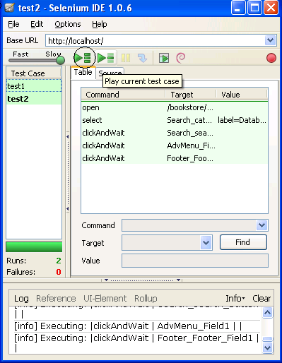
Creating a Test Suite
In the Selenium IDE you can create any number of test cases and save them as test suite.
To Run the test Suite click on the “Play entire test suite” button as shown below.
Test Suite with
Test1 & test2

Slide 17
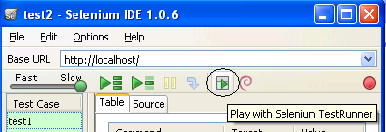
Playing The test Suite with Test Runner
Test Runner allows you to run the test case in a browser loaded with the Selenium-Core TestRunner.
Test runner is invoked by clicking the below Shown button in the IDE
On Clicking the Test Runner Button you will the window as seen in the next slide

Slide 18
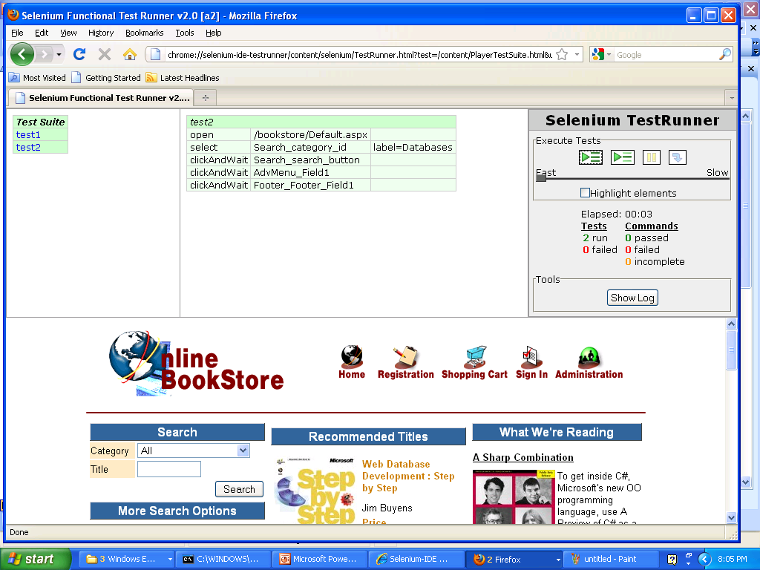
Test Runner
Click this button to run all the tests

Slide 19
Running Options
Run a Test Case
Click the Run button to run the currently displayed test case.
Run a Test Suite
Click the Run All button to run all the test cases in the currently loaded test suite.
Stop and Start
The Pause button can be used to stop the test case while it is running. The icon of this button then changes to indicate the Resume button. To continue click Resume.
Stop in the Middle
You can set a breakpoint in the test case to cause it to stop on a particular command. This is useful for debugging your test case. To set a breakpoint, select a command, right-click, and from the context menu select Toggle Breakpoint.

Slide 20
Running Options
Start from the Middle
You can tell the IDE to begin running from a specific command in the middle of the test case. This also is used for debugging. To set a start point, select a command, right-click, and from the context menu select Set/Clear Start Point.
Run Any Single Command
Double-click any single command to run it by itself. This is useful when writing a single command. It lets you immediately test a command you are constructing, when you are not sure if it is correct. You can double-click it to see if it runs correctly. This is also available from the context menu.

Slide 21
Adding Assertions to the Script
Selenese allows multiple ways of checking for UI elements.
Verifications and assertions are used to check if
an element is present somewhere on the page?
specific text is somewhere on the page?
specific text is at a specific location on the page?
Verifications and assertions are not one and the same.
If an assertion fails, the script will be aborted but if a verification fails the script will continue.

Slide 22
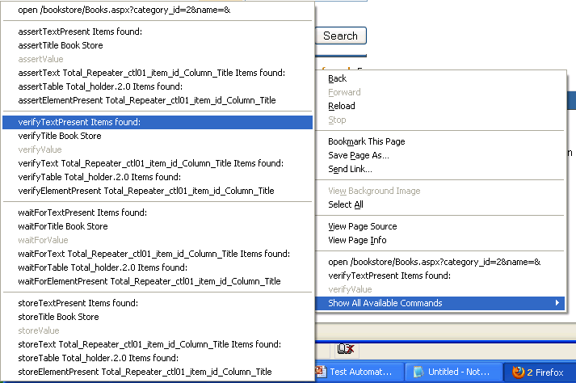
Verification Commands
verifyTextPresent
This command is used to check if a particular text is present in a page or not.
To add this command , While recording the test steps right click on the text item that you want verify. Once right clicked you can find an option “Show all commands”. On Clicking it you will find an option “verifyTextPresent”, select it

Slide 23
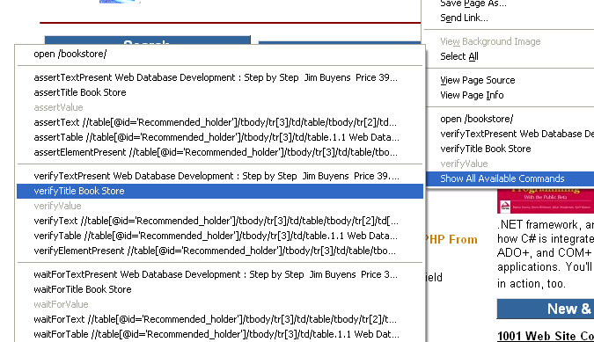
Verification Commands
verifyTitle
This command is used to check if the page title is correct or not.
To add this command , While recording the test steps right click any where on the page that you want verify. Once right clicked you can find an option “Show all commands”. On Clicking it you will find an option “verifyTitle”, select it

Slide 24
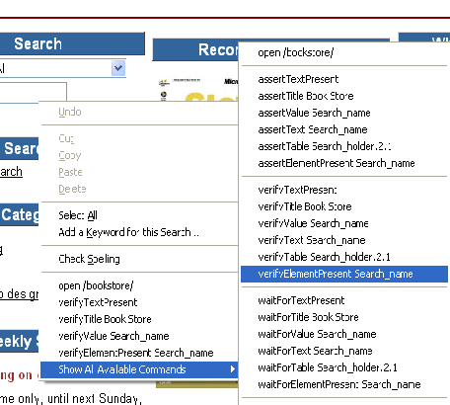
Verification Commands
verifyElementPresent
This command is used to verify if a page element is present in the page or not.
To add this command , While recording the test steps right click any element on the page that you want verify. Once right clicked you can find an option “Show all commands”. On Clicking it you will find an option “verifyElementPresent”, select it

Slide 25
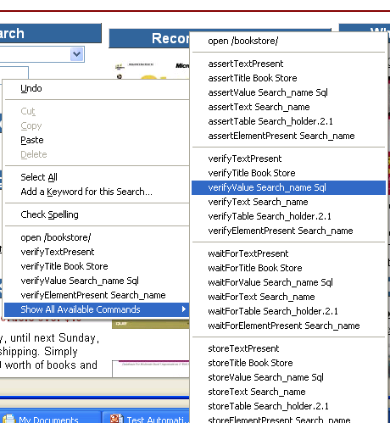
Verification Commands
verifyValue
This method is used to check if edit box has particular value or if the check box is on. Basically this method returns the value of present in the object.
To add this command , While recording the test steps right click any element on the page that you want verify the value of. Once right clicked you can find an option “Show all commands”. On Clicking it you will find an option “verifyValue”, select it.

Slide 26
Assertions
Assertions are same as Verifications. The only difference is, if the assertions fail the script will abort. But the script will continue run in case a verification point fails.
The steps for inserting the assertions is same as that of verification point.
While recording Right Click → Show all commands → select an assertion.

Slide 27
Assertion Statements
assertTextPresent
This will assert if the text is present in the page.
assertText
This will assert if a particular element is having the particular text.
assertTitle
This will assert if the page is having a proper title.
assertValue
This will assert if a Text box or check box has a particular value
assertElementPresent
This will assert if a particular UI Element is present in the page.

Slide 28

Selenium WaitFor Commands
waitForPageToLoad
This command will make the script to wait till the page loads.
Syntax is waitForPageToLoad(timeout); Time out is the maximum time the script will wait for the page to load.

Slide 29
Other waitFor Commands
waitForAlert
This command will wait for the alert message to appear
waitForTable
This command will wait for the Web table to completely load in the page
waitForTitle
This command will for the page Title to appear on the browser.
Other waitFor commands
Selenium has several other wait command like waitForText, waitForPopup and so on. These commands are generically called Synchronization commands

Slide 30
Store Commands
Store command are used to fetch the values from the application and store it in a variable. These variables can be used latter for validation purpose.
The Store command can be used to retrieve the page title, text from the page and other attributes from the application.

Slide 31
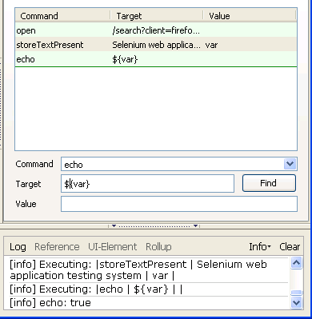
Echo Command
Echo command is used to print the value in to the selenium IDS log.
When printing a variable use ${var}
There are some limitations for this methods this has to be used with caution

Slide 32
Limitations of Selenium IDE
Can run the test only on Firefox
No Programming login (like loops, conditional statements) can be applied
Selenium IDE can execute scripts created in Selenese only.
It is difficult to use Selenium IDE for checking complex test cases involving dynamic contents

Slide 33
Selenium RC
A solution to cross browser testing.
A server, written in Java and so available on all the platforms.
Acts as a proxy for web requests from them.
Client libraries for many popular languages.
Bundles Selenium Core and automatically loads into the browser

Slide 34
Installing Selenium RC
Software Required
JDK 1.6 , selenium-remote-control-1.0.3 (this can be downloaded from http://seleniumhq.org/download/)
Installation Procedure
Selenium RC is simply a jar file and to run it we need java installed. (JDK 1.6 is preferred)
Once the Java is installed just unzip the selenium-remote-control-1.0.3. zip which was downloaded from the selenium site to a directory.

Slide 35
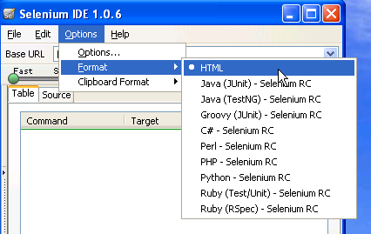
Selenium Test Automation Process
First Generate the Script using selenium IDE in the firefox IDE
Once the Scripts are recorded add assertions where ever required
Now format the Selenese test into the language of your choice. Please refer to the Image

Slide 36
Selenium Test Automation Process
Once the Selenese script is converted into your preferred language you can you can run them using Selenium Server.
For running the script you also need the client driver for that particular language.
To enhance the script we will require IDE like netbeans or Eclipse IDE
To Integrate the script and run them as a suite we will require build integration tools like Maven or Ant.

Slide 37
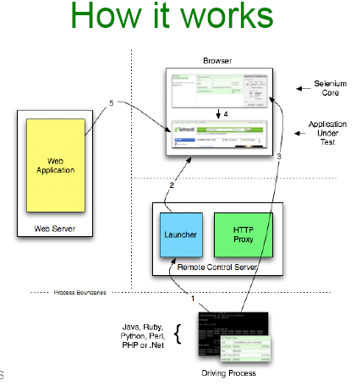
How Selenium Works

Slide 38
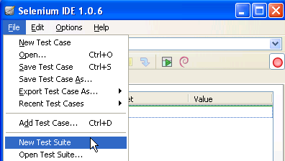
Running a Selenese Test on Different Browsers
Following are the steps to create a selenese test suite and run a test suite using selenium RC
Record a test case using selenium IDE and save it as “Test1.html” (say).
Record another test case using selenium IDE and save its as “Test3.html” (say).
In this way you can record any number of test case using selenium IDE and save them as <filename>.html
Then Create a New Test Suite using the File Menu. See the Image Below.

Slide 39
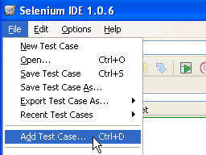
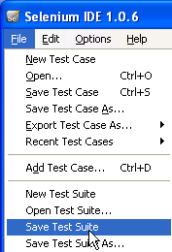
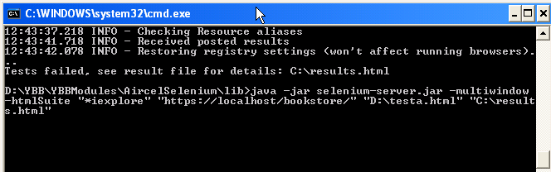
Selenese Suite cont..
Add the created test cases in to the suite as shown in Image1
Once the test cases are added to the suite save them as a test suite as in Image2
The Open the command prompt and navigate to the directory where Selenium RC (server) is placed.
In the command prompt Enter the command as shown below.

Slide 40
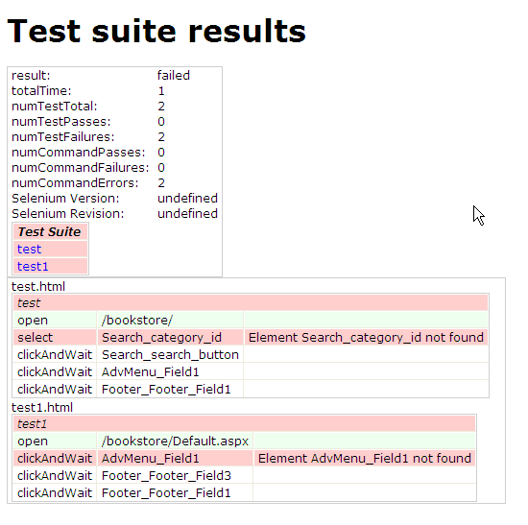
Selenese Suite cont..
Command :
java -jar selenium-server.jar -multiwindow -htmlSuite "*iexplore" "https://localhost/bookstore/" "D:\testa.html" "C:\results.html“
Once the command is run the results will be stored in the results.html file as shown below.

Slide 41
Selenium Test Case Development Using Java
Required Software
Selenium RC Server jar , Selenium Java Client Driver jar , JDK 1.6 +, Eclipse (or any other IDE), Junit jar and testng jar
For building the frame work we require continuous build integration tools like Ant, Maven or cruise control.

Slide 42
Client Drivers
Enables communication with Selenium Remote Control Server.
Functionality of Selenium is exposed via these drivers.
Available in Ruby, Python, Java, C-Sharp …and so on.
Give access to the rich features and libraries of the language, including their unit testing framework.
Makes it possible to develop automated scripts in the same language as product.
Which one you should use?
Whatever make sense in your context. Most Popular is java and for the training we will use java

Slide 43
Process of Developing Selenium Java Scripts.
Following are the steps for generating the
test scripts in java
Record the Script in Selenium IDE and format them into Java
Create a Selenium Java project in Eclipse and load all the necessary jar files
Copy the formatted Java code into the Eclipse and run the test.

Slide 44
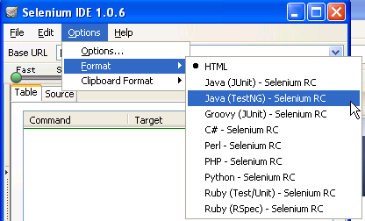
Formatting the recorded script into Java
Steps of formatting the code into java
Open the Browser and open the base URL of the application.
Open the Selenium IDE and start recoding the test steps.
Once the recording is done go to Menu → Options → Format → Java(TestNG) –Selenium RC
You can see the java code in the source tab of IDE. Save the test case with .java extension.

Slide 45
Setting Up an Eclipse Project for Selenium Automation
Eclipse is an open source community whose projects are focused on building an extensible development platform for building Java applications and frameworks. Eclipse is one of the best Java IDE and as a matter of face Eclipse is much more than a Java IDE.
We can configure a selenium project in eclipse and even run the scripts from eclipse.
Using eclipse its easy to enhance the recorded script. We can add power to the recorded script by parameterizing the test inputs and even validate the back values.
Eclipse also allows us to write reusable code for efficient test automation.

Slide 46

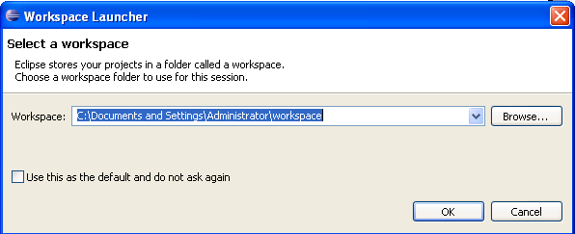
Installing Eclipse
Download the “Eclipse IDE for Java Developers” from the http://www.eclipse.org/downloads/ page.
Unzip the downloaded zip file from the above site into a directory.
Once the unzipping is over open the folder and double click on the icon and it will open a dialog box as shown below.

Slide 47
Setting up the workspace
Create a folder say (selenium) in any one of the directory and change the workspace location to the directory created by you. Then click ok button.
On doing so you will see the eclipse welcome screen if you are doing it for the first time. On the welcome screen click on the workbench icon to open the project explorer.
When you to try to open the eclipse from next time it will directly show the project explorer as shown in the next slide.

Slide 48
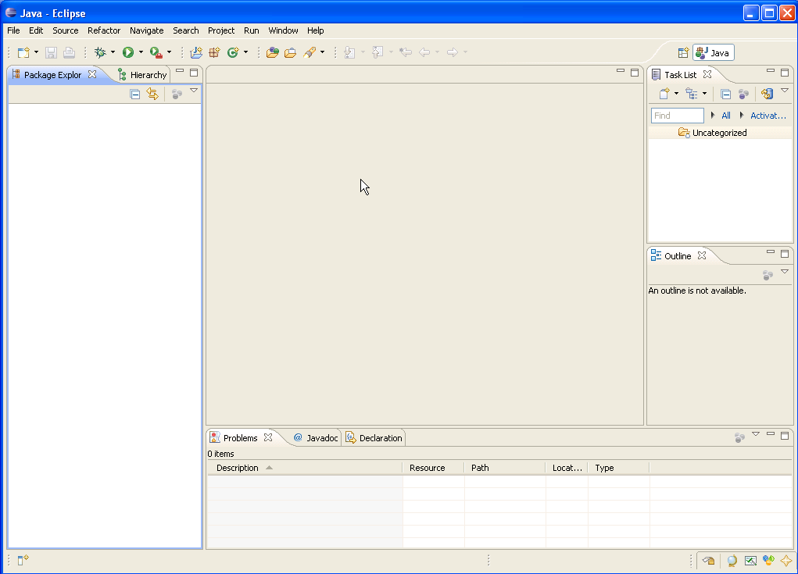
Eclipse IDE
Scrip View
Package
Explorer
console

Slide 49
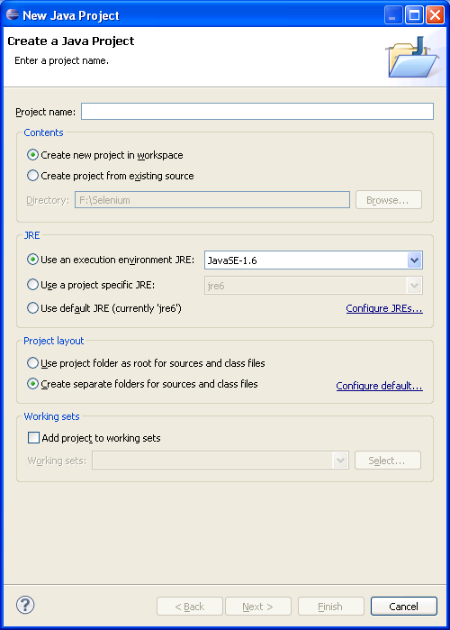
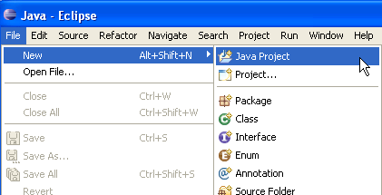
Create a Project In eclipse
File → New → Java Project
Specify the project name and click finish

Slide 50
Adding the required Jars
Open the folder contain the selenium project that you have just created. Inside that folder create another folder with name “lib”
Inside the lib folder place the following jar files.
junit-4.8.1.jar
selenium-java-client-driver.jar
selenium-server.jar
testng-5.12.jars
After placing the jar file in lib come back to the eclipse and click on the project explorer strip and press F5. You should see the all the jar files under the lib folder in the project explorer as shown in the Image in next slide.

Slide 51
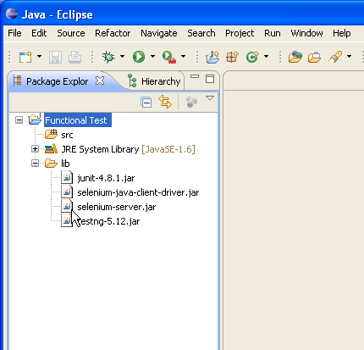
Selenium Libraries

Slide 52
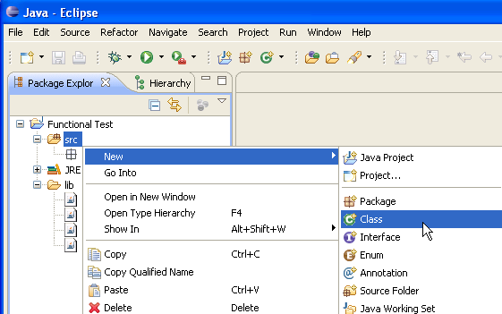
Creating a package and adding a class file
In the eclipse → Package Explorer → right click on the src (source) folder. In that select New → Package and give a name to the package. See the Picture1
Now right click on the created package and click on new → class and provide a class name. You will see a java script template as seen in the next slide

Slide 53
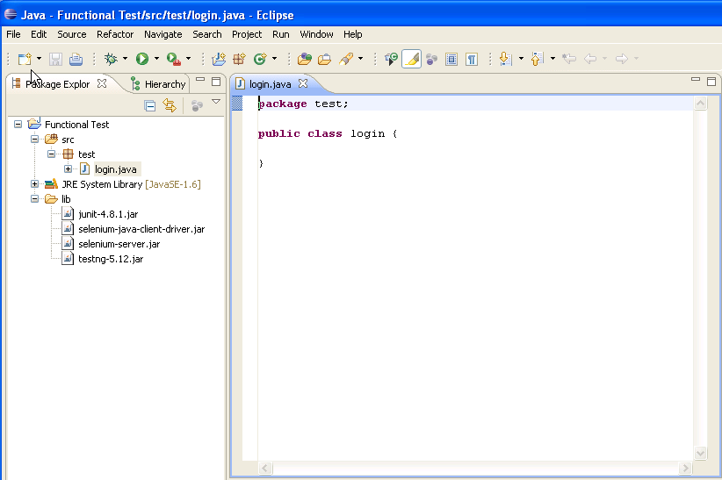
Eclipse IDE with Java Script Template
Your IDE should look like this
This is where you have copy the
Java code that you formatted in the
Selenium IDE

Slide 54
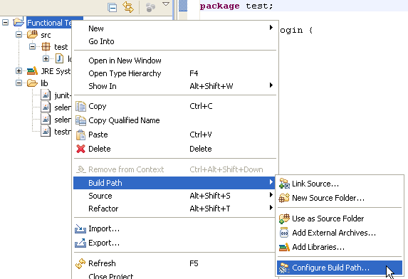
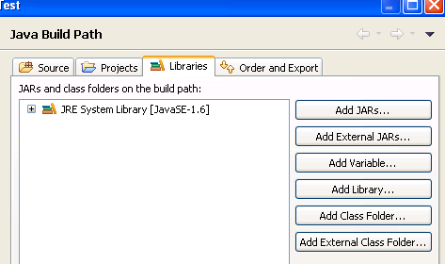
Adding the Jar files to the class path
Right Click on the Project
Select Build Path → Configure Build path
On the next window click on the libraries tab and click on the add jars tab

Slide 55
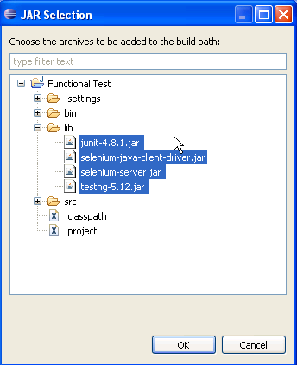
Adding the Jar files to the class path
As you click on the add jars button a window showing all the jar files will be opened. Select all the jar files and click on ok button
By doing this step we are almost ready to write the script and run it.

Slide 56
Creating the test script inside the class file
Copy the code that was formatted in the selenium IDE and paste it in the Eclipse IDE script template.
Make sure the class name that you created and the class name in the script are same
Make sure that you have add the methods setUp and tearDown

Slide 57
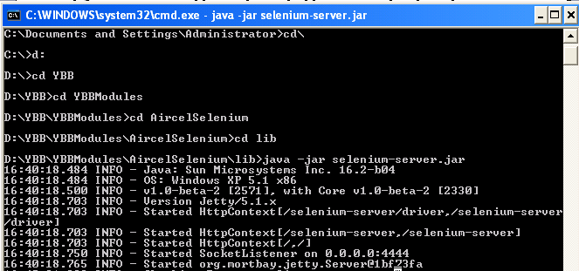
Running the test through Eclipse
Start the Selenium Server
For this open the command prompt and go to the folder where the selenium server is present.
Run the command “java -jar selenium-server.jar”
The Selenium server will start running and you can see the message in the command prompt.

Slide 58
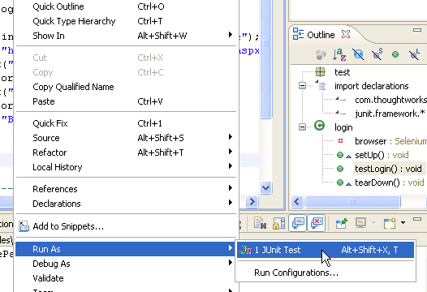
Running the test through Eclipse
Once the server is up go to the eclipse and right click on the script.
In that select Run As → JUnit Test. See the image below. After this you will get will see that the script has run successfully in the window that’s shown in the next slide.

Slide 59
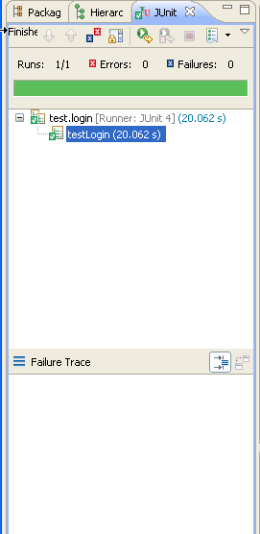
Selenium Results Strip in the Eclipse IDE
success
failure

Slide 60
Components of the Selenium test Script
setUp method
This method prepares the selenium server to run the test. This method basically hooks to the selenium server and opens up the base URL of the application
test*** method
The methods with the name test will actually run the tests on the application. There can be any number of test methods in the app
tearDown method
This method will run after the end of the test. This test will disconnect with the server and makes room for the next tests to run the tests.

Slide 61
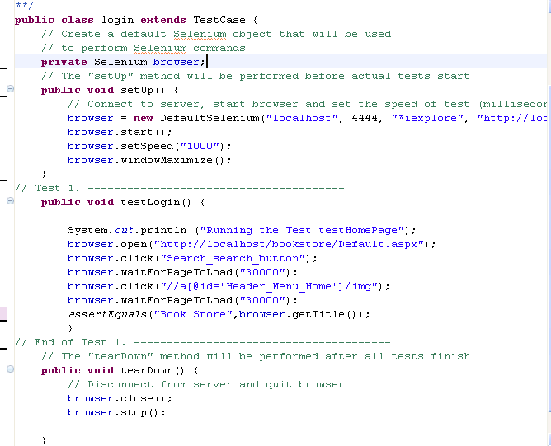
Script View

Slide 62
Enhancing the Selenium commands
The generated selenium command can be enhanced by writing java commands. Using java methods we can do parameterization and data base validation.
More over java methods can be used for to perform some complex validations and testing activities.
The best way to use java methods is used to is have a Java IDE like eclipse.

Slide 63
Some Java Basics
Java Data Types
Int, float, String, char, Boolean and double
Declarations
String s = “Selenium”;
Int i = 20;
float cur = 3.35;
Operators
* ,/ ,% ,+, - are the mathematical operators
* ,/, %, have a higher precedence than + or -

Slide 64
Relational Operators
== Equal (careful)
!= Not equal
>= Greater than or equal
<= Less than or equal
> Greater than
< Less than

Slide 65
Programming Elements
If Condition
if (name != “selenium”)
{
System.out.print(“Tool Changed”);
}
Else
{
System.out.print(“Tool is ok”);
}
Loop n times
for ( i = 0; i < n; n++ )
{
// this code body will execute n times
// I from 0 to n-1
}

Slide 66



Use string functions

Slide 67
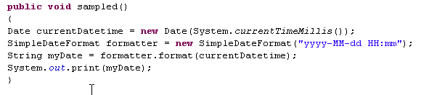
Date Functions
Required Packages
import java.util.Date;
import java.text.SimpleDateFormat;
Sample Code

Slide 68
Example 1 – Get the values from the list box and check if the value “HTML” is present in it
Implementation Steps
First get the values from the list box
To get the values from the list box or any other HTML element we need to know its Xpath. (use Xpath checker)
The values taken from the list box are stored in a variable.
Use the indexOf method to find if “HTML” is present in the extracted variable.

Slide 69
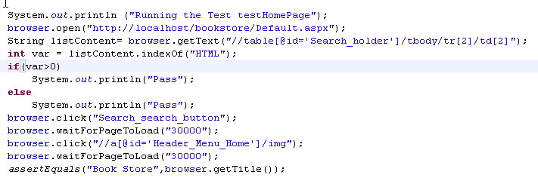
Screen Shot of the Example Script
Xpath Locator

Slide 70
Parameterization
Parameterization is to same run the script with multiple set of data.
The data will be stored in a CSV file.
We will have write a program to read the values from the excel line by line and replace the values.
For reading the values from a CSV file we will require the following packages
import java.io.File;
import java.io.BufferedReader;
import java.io.FileReader;
import java.util.StringTokenizer;

Slide 71
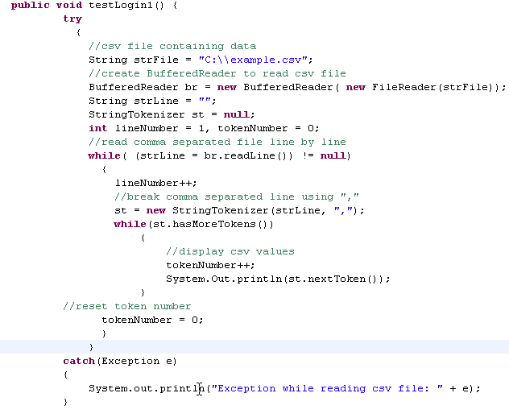
Parameterization Example

Slide 72
Ant Integration
Ant is a free tool from the Apache Jakarta Group
Originally written by James Duncan Davidson
on an airplane from Europe to the US...
Like ‘make’ for Java – only better
Uses an XML file to drive its action
Extremely powerful and modular
Easily extensible
Written in Java so it is cross platform

Slide 73
To Integrate with ANT
Download ANT and copy it into any of the directory
Create a JAVA_HOME environment Variable
Create a ANT_HOME environment variables
Add the ANT bin path to windows path environment variable
Create a build file to load all the jar files and create targets to run the selenium tests using the build file

Slide 74
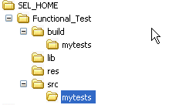
Defining a folder Structure for Selenium ANT task

Slide 75
Running the ANT selenium task
Start the selenium server through the command prompt
Then go the folder where the selenium tests are stored
Make sure that the build.xml file is present in that location
Now run the command “ant” from the command prompt
You can see the test running and the results will be saved in the results.txt file.

Slide 76
Selenium-Grid
Selenium-Grid allows the Selenium-RC solution to scale for test suites or test suites to be run in multiple environments.
With Selenium-Grid multiple instances of Selenium-RC are running on various operating system and browser configurations, each of these when launching register with a hub. When tests are sent to the hub they are then redirected to an available Selenium-RC, which will launch the browser and run the test.
This allows for running tests in parallel, with the entire test suite theoretically taking only as long to run as the longest individual test.

Slide 77
How to Grid
Download Selenium Grid latest binary distribution and unpack it on your computer.
Go at the root of selenium grid directory and validate your installation:
cd selenium-grid-1.0
ant sanity-check
Go to the selenium distribution directory and launch in a new terminal:
ant launch-hub
Check out that the Hub is running by looking at its console in a browser:
http://localhost:4444/console (See the Browser in the next slide)

Slide 78
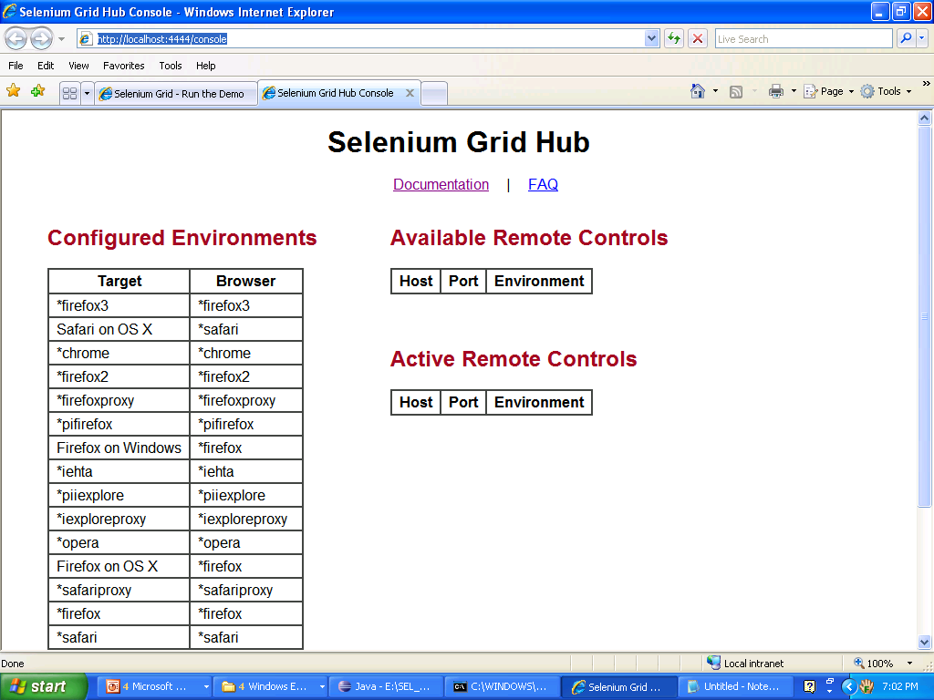

Slide 79
How to Run
In a new terminal enter the following command
ant launch-remote-control
Based on your target file you can run either in sequence or in parallel

Slide 80
What's good?
Relatively easy to automate web UI tests
Record/Replay for regression tests
RC allows integration with CI and JUnit/FitNesse tests

Slide 81
What's bad?
Speed: RC->Browser communication is a speed bottleneck (run in grid, overnight)‏
UI is brittle, tests depending on the UI break a lot (DSTL might fix this, page abstractions as well)‏
Data-backed tests are not easily repeatable (integrate with DB test engines)‏

Slide 82
Links
http://gojko.net
http://www.openqa.org
http://www.solutionsiq.com/agile2008/agile-2008-domain.php
http://storytestiq.solutionsiq.com
http://www.cubictest.com
http://fitnesse.info/webtest

